Slide 1



VOIS Innovation
Marathon 2.0

Slide 2
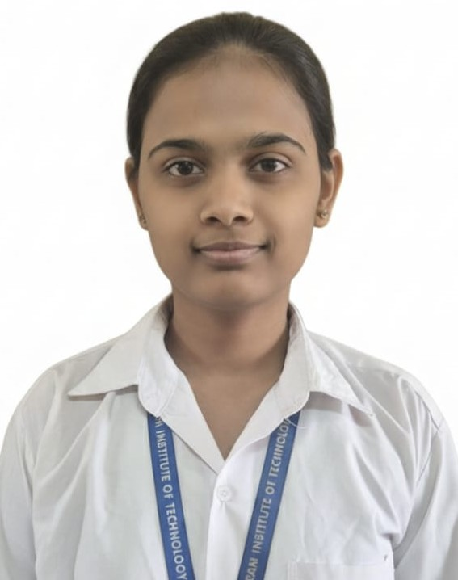

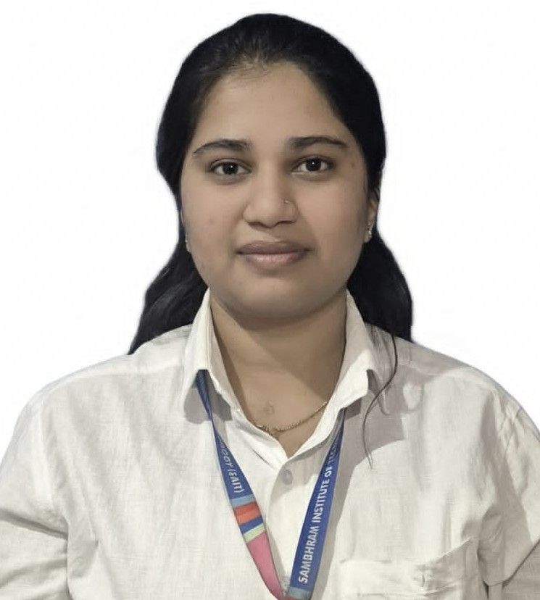
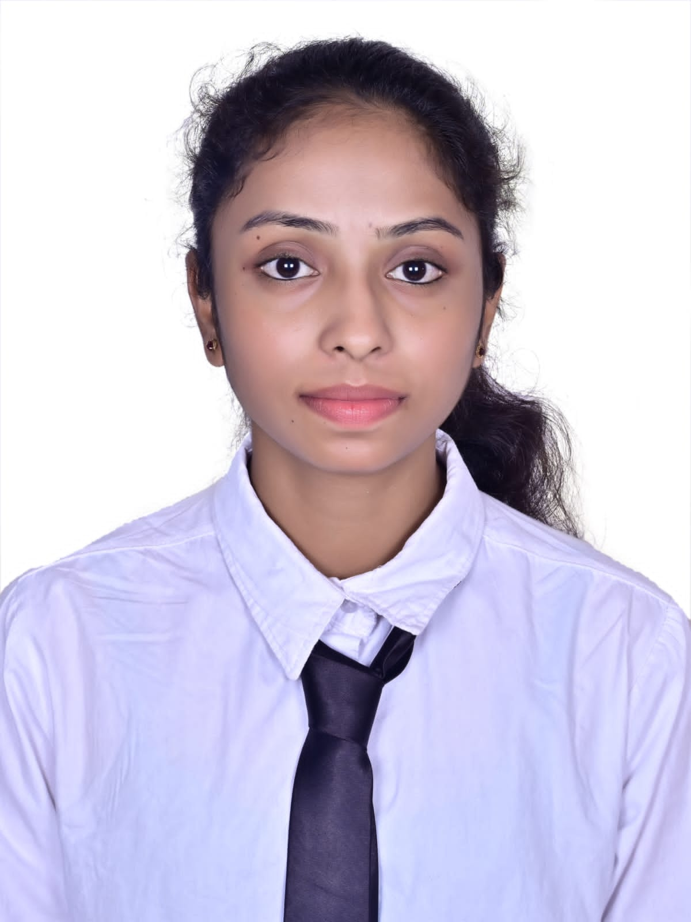
Project Title :
AI ENABLED DAM AUTOMATION SYSTEM
TEAM LEAD
SHREYA GALI
ECE
Team No 28
Insert your professional photo
College Name
Sambhram Institute of Technology,
Bangalore
RAKSHITHA G ECE
SPURTHI N
ECE

Slide 3
Problem Statement
Dams are essential for water storage, flood control, irrigation, and power generation.
Most dams still operate using manual control and fixed rules.
Such systems cannot respond quickly to sudden rainfall, inflow, or climate changes.
This leads to flood risks, water wastage, structural stress, and human error.
There is a need for an AI-based automated dam system to predict inflow and control gates safely.

Slide 4
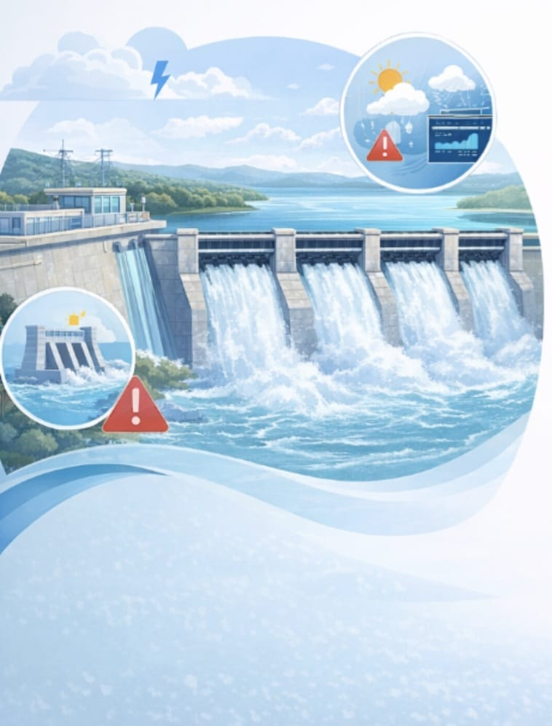
Need of Project
The need for this project arises due to:
Increasing dam failures and flood disasters.
Requirement for continuous real-time surveillance.
Rising demand for water security and public safety.
Need to reduce manual labor and maintenance cost.
Requirement for early crack detection and intrusion alerts.

Slide 5

Proposed Solution
AI-based Crack & Human Detection: YOLOv5 deep learning model analyzes camera images to detect cracks on dam surfaces and unauthorized human presence.
IoT Sensor Monitoring: Sensors continuously monitor water level, rainfall, pH, and turbidity.
Automated Gate Control: Dam gates are operated automatically based on water level and rainfall conditions.
Alert& Notification System: Emergency alerts are sent via buzzer, LCD, and IoT dash boards.

Slide 6
Solution Overview
Intelligent Monitoring & Detection : Uses IoT sensors and AI (YOLOv5) to continuously monitor water level, rainfall, water quality, structural cracks, and human intrusion in real time.
Automated Decision & Control : A central controller (ESP32) analyze sensor data and automatically operates dam gates using servo motors to regulate water flow and prevent flooding or structural stress.
Alerting & Preventive Safety System : Provides early warnings through LCD, buzzer, and IoT dashboards, transforming dam management from manual and reactive to predictive, automated, and safer.

Slide 7


Technology used
1
IoT Sensors – Real-time data monitoring
2
AI & YOLOv5 – Crack and human detection
3
ESP32 / Arduino – Data processing and control
4
Automation Systems – Automatic gate operation & alerts
5

Slide 8
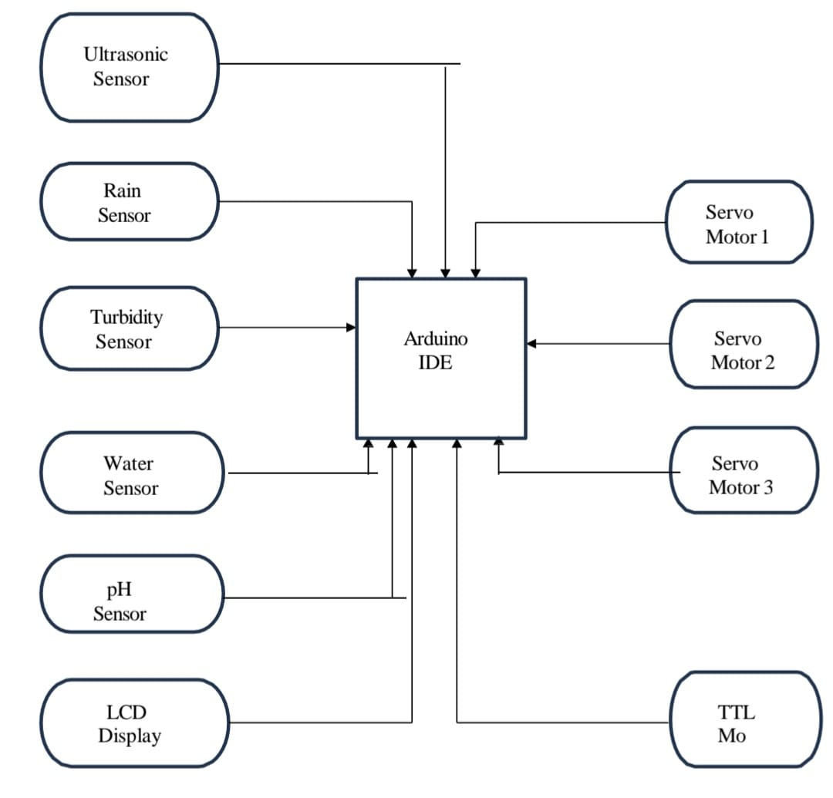
Technical flow diagram -

Slide 9
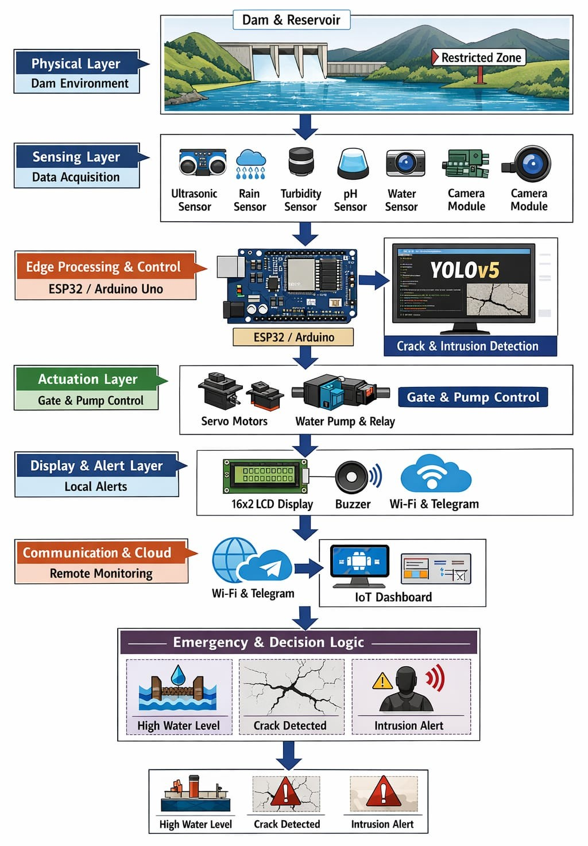
Architecture Blueprint

Slide 10
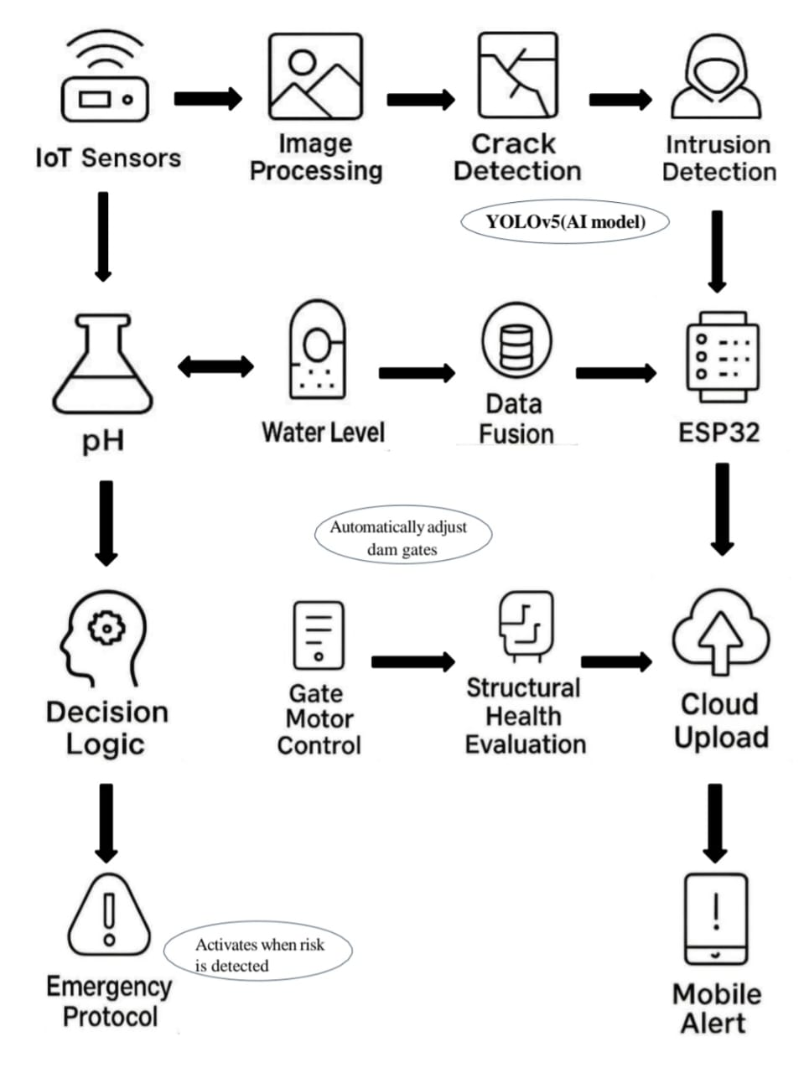
Workflow diagram

Slide 11
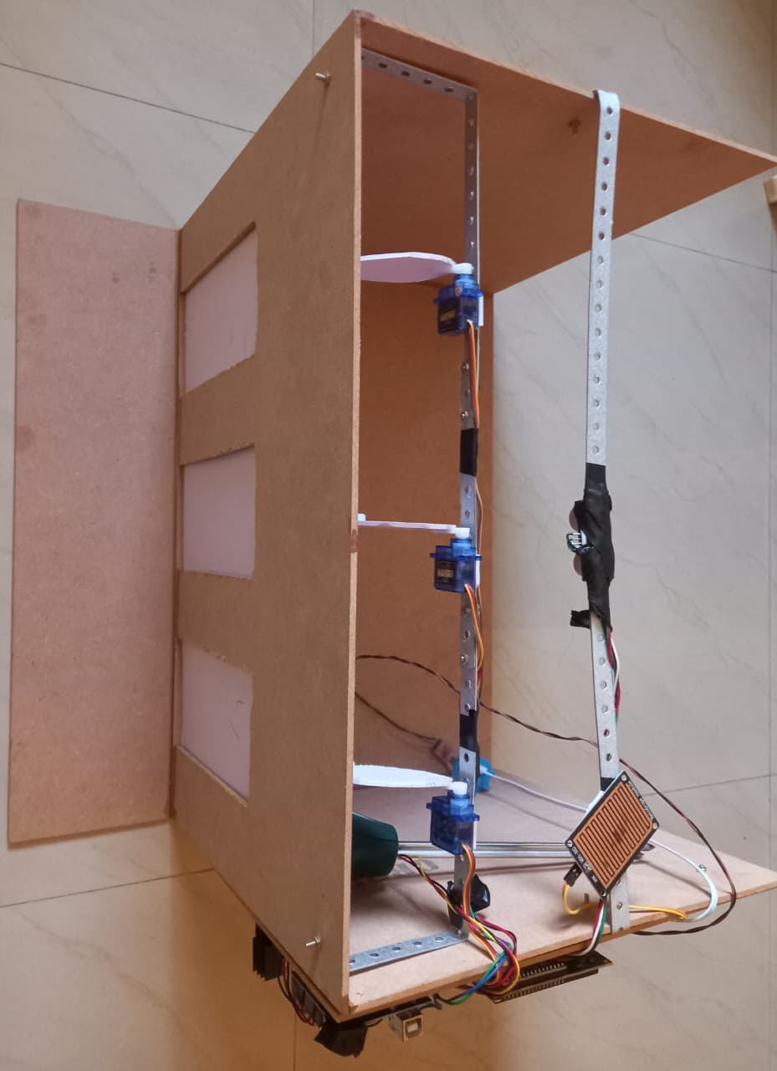
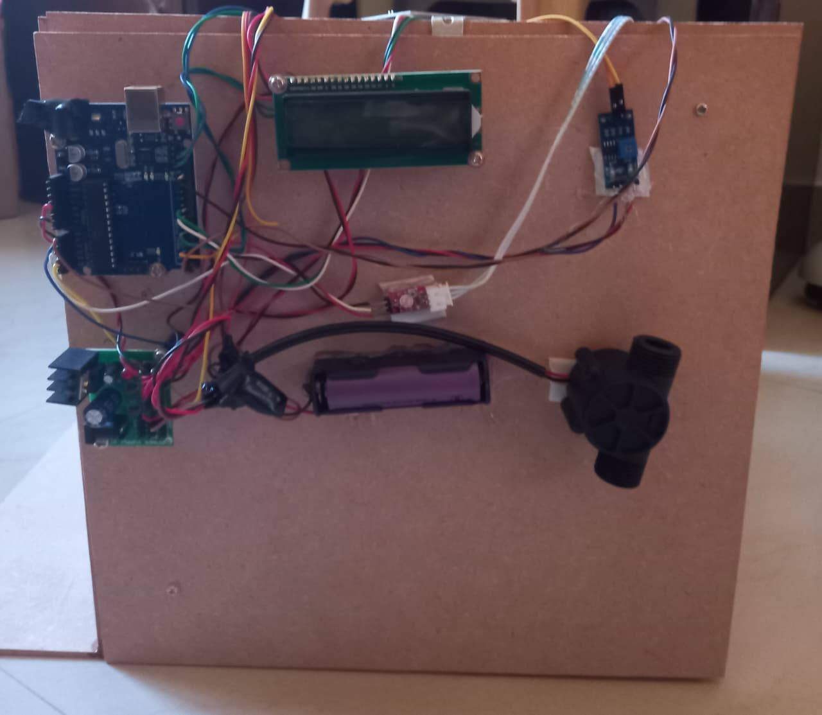
Screen shots of your project -

Slide 12
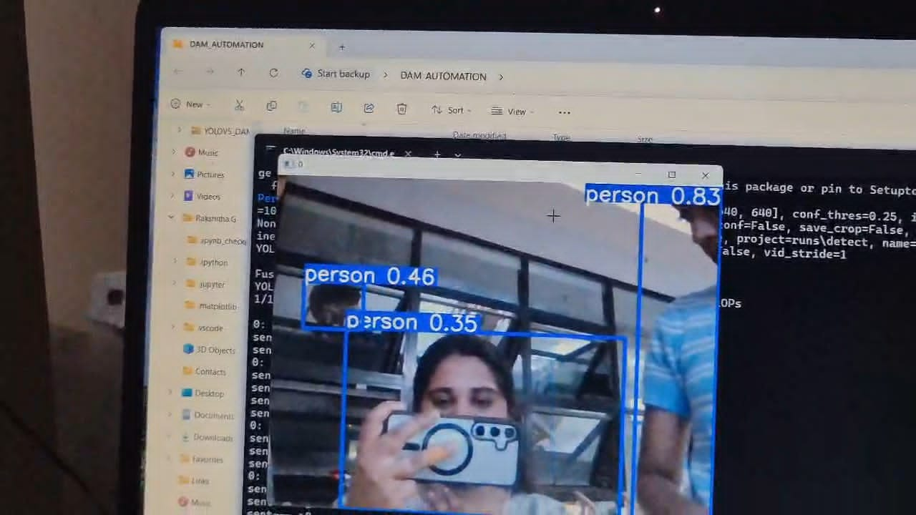
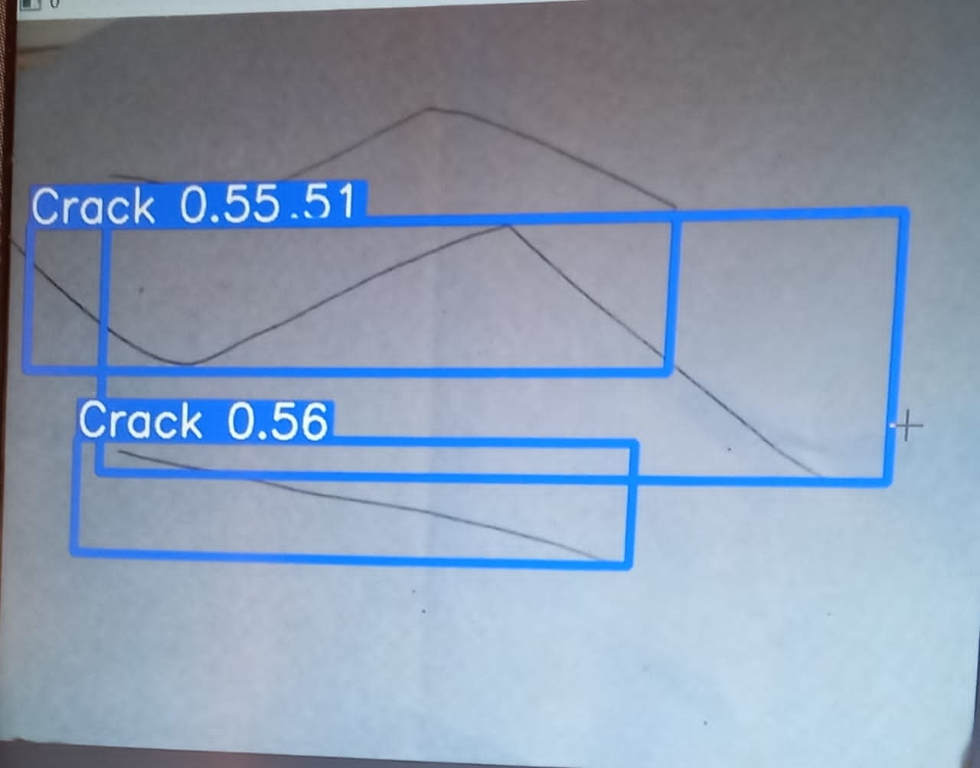
Screen shots of your project -

Slide 13
Role of Agentic AI and Gen AI in the solution
Agentic AI enables automatic decision-making and control of dam gates and pumps without human intervention.
Agentic AI predicts flood risks and structural issues using sensor and historical data.
Generative AI converts system data into easy-to-understand alerts and reports for authorities.

Slide 14
Novelty and Uniqueness
1
2
3
4
AI-based crack and intrusion detection using YOLOv5 instead of only sensor-based monitoring.
Fully automated dam gate control driven by real-time sensor data and intelligent decision logic.
Integrated monitoring of water level, rainfall, and water quality in a single unified system.
Instant remote alerts via IoT (Telegram/Wi-Fi) enabling faster emergency response and reduced human dependency.

Slide 15
Git Hub Link
https://github.com/SHREYA200489/AI-ENABLED-DAM-AUTOMATION-SYSTEM.git

Slide 16
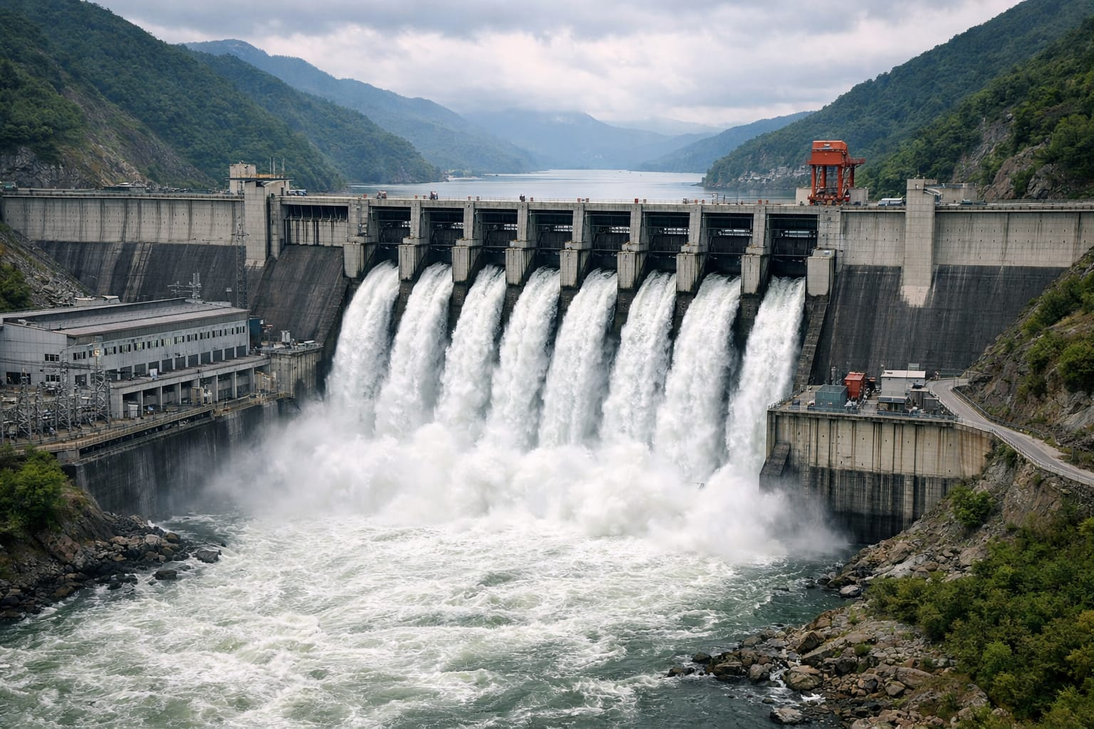
Future Scope
Predictive flood forecasting using advanced machine learning models.
Satellite and drone integration for large-scale dam and catchment monitoring.
Digital twin of the dam for simulation and risk analysis.
Multi-dam network monitoring through a centralized cloud platform.
Edge AI deployment for faster, offline decision-making and improved reliability.

Slide 17
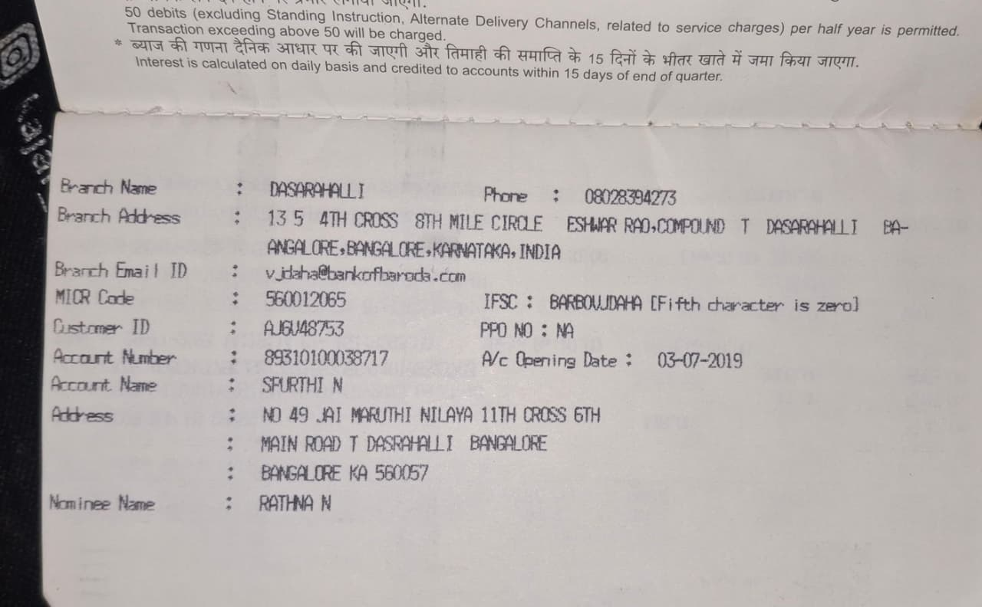
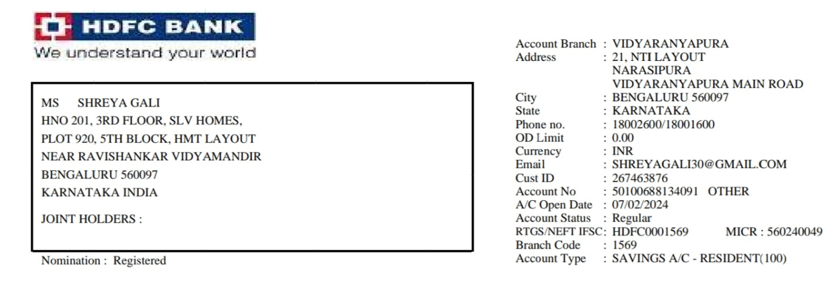
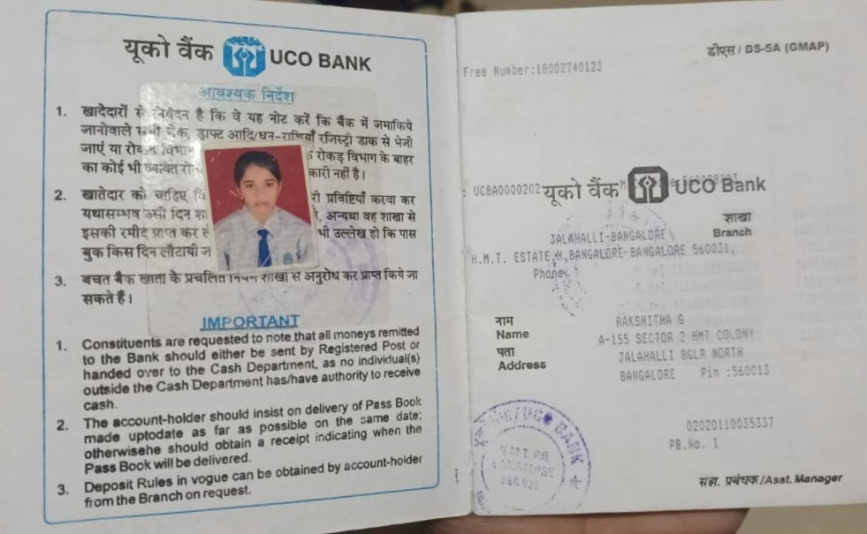
Bank Details
Full Name (as per bank records): | Bank Name | Branch Name | Account Number | Account Type (Savings / Current) | IFSC Code
SHREYA GALI | HDFC BANK | VIDYARANYAPURA | 50100688134091 | SAVINGS ACCOUNT | HDFC0001569
RAKSHITHA G | UCO BANK | JALAHALLI, H.M.T ESTATE | 02020110035337 | SAVINGS ACCOUNT | UCBA0000202
SPURTHI N | BANK OF BARODA | DASARAHALLI | 89310100038717 | SAVINGS ACCOUNT | BARB0VJDAHA
Team Member 1
Passbook : SHREYA GALI
Team Member 2
Passbook : RAKSHITHA G
Team Member 3
Passbook : SPURTHI N

Slide 18
Thank You

